Slide 1
Uniform Circular Motion

Slide 2
Newton’s Second Law - Yet Another Review!

Slide 3
Uniform Circular Motion

Slide 4
Acceleration in Circular Motion
When an object travels in a circle, its velocity is constantly changing (in direction at least).
That means the object has a non-zero acceleration even if it moves at constant speed.

Slide 5
Important Facts About Velocity and Acceleration Vectors

Slide 6
What is the Direction of Acceleration?

Slide 7
Example: A Rock on a String
Twirl a 1 kg rock attached to a string in a 1 m radius vertical circle. The speed is 4 m/sec. What forces act on the rock and what are the directions of those forces?

Slide 8
Case A: Rock at the Top of the Circle

Slide 9
Case B: Rock at the Bottom of the Circle

Slide 10
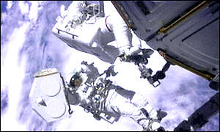
Class #12 Problems of the Day

Slide 11
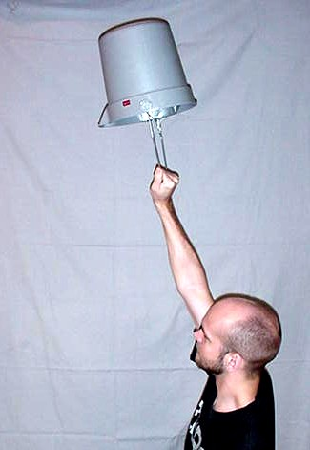
Discussion Swinging a Water Bucket Overhead

Slide 12
familiar forces, such as tension, friction, or the normal force. Equation given simply
tells us how the force needs to act—how strongly and in which direction—to cause
the particle to move with speed v in a circle of radius r.

Slide 13
For uniform circular motion,
and the sum of the forces along the r-axis must equal ma_{r}, where a_{r} is the centripetal
acceleration.
the sum of the forces along axis along tangential direction must be equal zero,

Slide 14
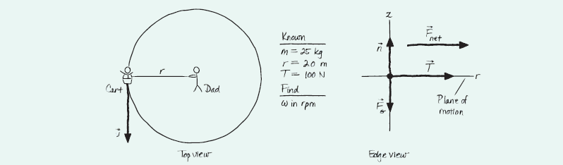
An energetic father places his 20 kg child on a 5.0 kg cart to which a 2.0-m-long rope is attached. He then holds the end of the rope and spins the cart and child around in a circle, keeping the rope parallel to the ground. If the tension in the rope is 100 N, how many revolutions per minute (rpm) does the cart make? Rolling friction between the cart’s wheels and the ground is negligible

Slide 15
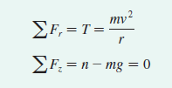



Slide 16
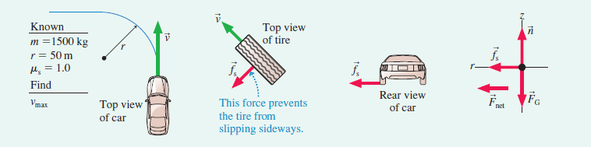
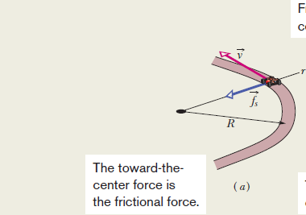
What is the maximum speed with which a 1500 kg car can make a left turn around a curve of radius 50 m on a level (unbanked) road without sliding?
Static friction f s pushes sideways on the tire, toward the center of the circle.
If f _{s} had a component either parallel to v u or opposite to v, it would cause the car to speed up or slow down. Because the car changes direction but not speed.
static friction must be perpendicular to v f _{s} causes the centripetal acceleration of circular motion around the curve.

Slide 17



Slide 18
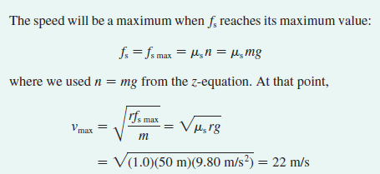
The maximum turning speed is reached when the static
friction force reaches its maximum f_{s max} = m_{s} n. If the car enters
the curve at a speed higher than the maximum, static friction will
not be large enough to provide the necessary centripetal acceleration
and the car will slide.

Slide 19
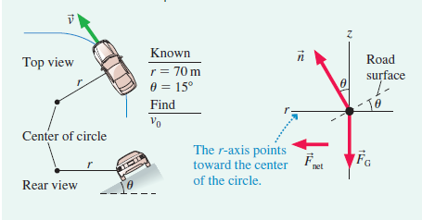
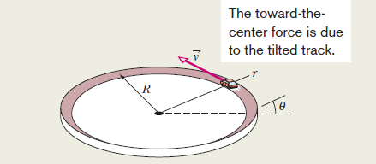
A highway curve of radius 70 m is banked at a 15° angle. At what speed v₀ can a car take this curve without assistance from friction?

Slide 20
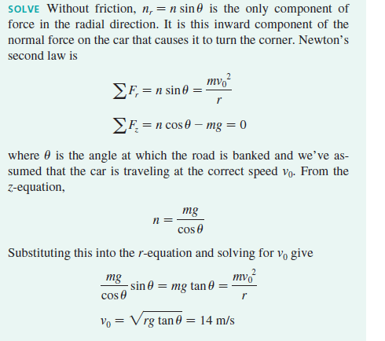

Slide 21
